Slide 1
Data Analysis of Heart Failure Using the Medical Expenditure Panel Survey (MEPS) Dataset

Slide 2
Introduction
This slide serves as an introductory overview of our comprehensive analysis of heart failure data. In this presentation, we delve into the critical medical condition of heart failure, shedding light on its prevalence, underlying causes, available treatments, and influential factors. Our research aims to answer key questions surrounding this condition, utilizing data-driven insights to uncover patterns and trends.
Heart failure, a prevalent and life-altering condition, affects millions of individuals worldwide. Understanding its intricacies is crucial for improving patient outcomes and healthcare strategies. Through this analysis, we embark on a journey to explore the nuances of heart failure, drawing from a dataset sourced from the Medical Expenditure Panel Survey (MEPS). This dataset comprises a diverse set of variables that offer valuable insights into heart failure outcomes and healthcare costs.
As we progress through this presentation, we will navigate the various phases of our analysis, from data preprocessing and exploratory data analysis to statistical testing and final insights. Our goal is to provide a comprehensive understanding of heart failure, fueled by data-driven evidence, and underscore the transformative potential of health data analytics.

Slide 3
About the Dataset
This slide provides essential information about the heart failure dataset, setting the stage for our analysis. The dataset is sourced from the Medical Expenditure Panel Survey (MEPS), a valuable resource for studying healthcare and health-related issues in the United States. It consists of numerous variables that offer insights into heart failure, a prevalent cardiovascular condition.
Data Source: The heart failure dataset is derived from clinical records and observations of patients who have experienced heart failure. It is obtained from the MEPS data with an the ICD-10 code of I50. It captures essential information about these patients, allowing for a comprehensive analysis of factors related to heart failure.The dataset has 13 columns and 565 rows.

Slide 4
About the Dataset cont’d
Key Features and Variables
The dataset consists of 13 columns, each representing a specific variable or feature and 565 data records. Here is a brief description of these features:
i.Age: Age of the patient.
ii.Anaemia: A binary variable indicating whether the patient had hemoglobin levels below the normal range (0 for no, 1 for yes).
iii.Creatinine Phosphokinase: The level of creatine phosphokinase in the blood, measured in mcg/L.
iv.Diabetes: A binary variable indicating whether the patient had diabetes (0 for no, 1 for yes).
v.Ejection Fraction: Ejection fraction is a measure of how much blood the left ventricle of the heart pumps out with each contraction.
vi.High Blood Pressure: A binary variable indicating whether the patient had hypertension (0 for no, 1 for yes).
vii.Platelets: Platelet count in the blood, measured in kiloplatelets/mL.

Slide 5
About the Dataset cont’d
viii.Serum Creatinine: The level of serum creatinine in the blood, measured in mg/dL.
ix.Serum Sodium: The level of serum sodium in the blood, measured in mEq/L.
x.Sex: The gender of the patient (0 for female, 1 for male).
xi.Smoking: A binary variable indicating whether the patient was a smoker (0 for no, 1 for yes).
xii.Time: The time of the patient's follow-up visit for the disease in months.
Death Event: A binary variable indicating whether the patient deceased during the follow-up period (0 for no, 1 for yes).

Slide 6
Research Questions
Our primary research questions guided this comprehensive analysis of heart failure data. These questions are pivotal in understanding the condition:
Economic Impact: We explored the yearly medical expenditure of individuals with heart failure, unveiling its substantial economic burden on patients and the healthcare system.
Healthcare Disparities: We examined how healthcare costs vary across social determinant factors, including sex, region, family income, and race, shedding light on healthcare disparities.
Risk Factors: We investigated relationships between heart failure and environmental factors, providing insights into potential preventive measures.

Slide 7
Related Work
Existing studies on heart failure have paved the way for our analysis. Key findings from prior research include:
Prevalence: Heart failure is a global concern, with millions affected each year, making it a leading cause of mortality.
Behavioral Risk Factors: Preventive strategies address modifiable risk factors like tobacco use, unhealthy diet, obesity, physical inactivity, and alcohol misuse.
Early Detection: Identifying and managing cardiovascular risk factors play a pivotal role in early detection and effective management.

Slide 8
Methods
Our analysis was driven by a robust methodology:
Data Preprocessing: We meticulously prepared the data, selecting relevant variables, addressing missing values, and removing outliers to ensure data quality.
Statistical Tests: We employed t-tests, chi-squared tests, and correlation analysis to answer research questions based on variable types and distribution characteristics.
Data Visualization: We utilized data visualization techniques to enhance data exploration, understanding, and presentation.

Slide 9
Data Preprocessing
Data preprocessing is a cornerstone of our analysis, ensuring data integrity and relevance:
Variable Selection: We carefully curated variables related to heart failure, ensuring that our analysis focuses on the most pertinent factors.
Handling Missing Data: We addressed missing data by employing appropriate methods, enhancing the dataset's completeness.
Outlier Removal: We identified and removed outliers, minimizing their impact on statistical analyses.

Slide 10
Visualization and Exploratory Data Analysis(EDA) 1
EDA plays a crucial role in unraveling the intricacies of heart failure data:
Descriptive Statistics: We leveraged descriptive statistics to summarize and understand the dataset, revealing key trends and distributions.
Visualizations: Through visualizations like histograms and scatter plots, we gained insights into variable relationships and patterns within the data.

Slide 11
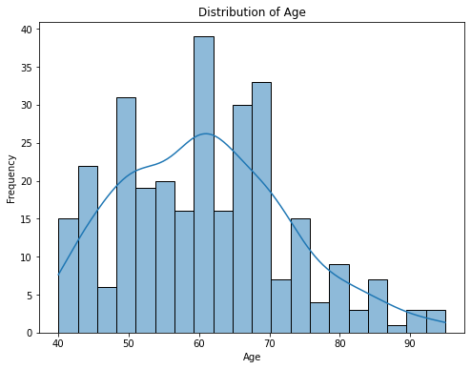
Visualizations & Exploratory Data Analysis(EDA) 2
a) Histograms

Slide 12
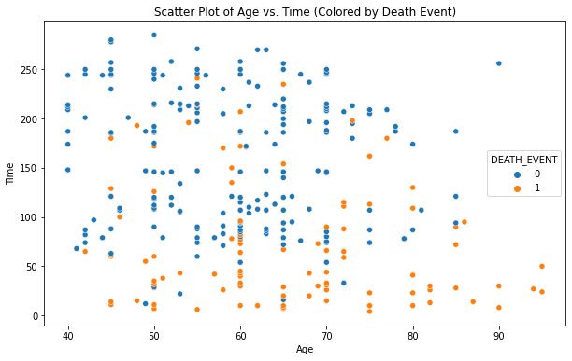
Visualiztions and Exploratory Data Analysis(EDA) 3
b) Scatter plot

Slide 13
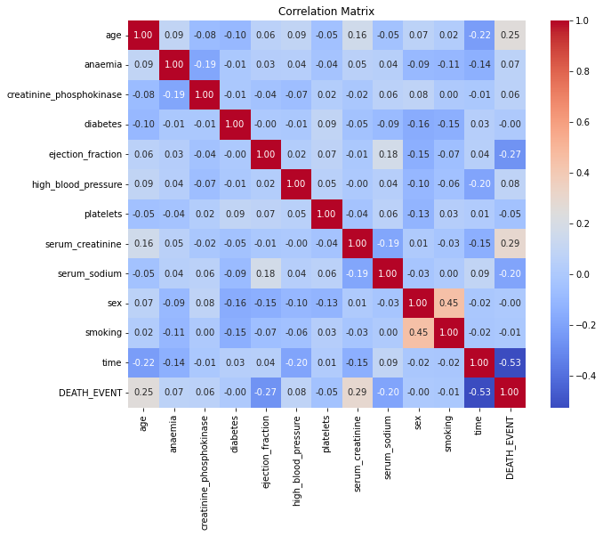
Visualizations & Exploratory Data Analysis(EDA) 4
c) Correlation Matrix
These interpretations provide a concise summary of each slide, emphasizing the key points and contributions of each phase of our analysis.

Slide 14
Statistical Tests
Our analysis leveraged various statistical tests to uncover critical insights:
T-Tests: We used t-tests to compare means between two groups, such as surviving and non-surviving patients. These tests allowed us to determine significant differences in variables like ejection fraction.
Chi-Squared Test: The chi-squared test was applied to categorical variables, examining associations between variables like diabetes and high blood pressure with heart failure outcomes. This helped identify statistically significant relationships.
Correlation Analysis: Pearson's correlation coefficient was utilized to quantify the strength and direction of linear relationships between numerical variables. This allowed us to explore how variables like serum creatinine and the severity of illness are interconnected.
Incorporating these statistical tests was crucial in providing robust evidence for our research questions, helping us draw meaningful conclusions about heart failure and its associated factors.

Slide 15
Final Analysis
Our comprehensive analysis journey culminates in these critical findings and insights:
Economic Burden: Our analysis reveals the significant economic burden of heart failure, as evidenced by the high total health expenditures of affected individuals.
Risk Factors: Key risk factors such as high blood pressure (hypertension) and diabetes showcase notable associations with heart failure outcomes. These conditions warrant vigilant monitoring and management.
Clinical Significance: The ejection fraction, a clinical measure of heart function, emerges as a crucial predictor of heart failure survival. A lower ejection fraction indicates reduced cardiac efficiency, posing a higher risk.

Slide 16
Results
Our statistical tests unveil pivotal insights:
T-Tests: Comparing ejection fraction means between surviving and non-surviving patients shows a significant difference (p < 0.05), emphasizing its clinical relevance.
Chi-Squared Test: The chi-squared test indicates a statistically significant association between diabetes and high blood pressure with heart failure outcomes.
Correlation Analysis: Pearson's correlation coefficients revealed a strong positive correlations between serum creatinine levels and the severity of illness (attacks/year), underlining the clinical importance of kidney function in heart failure.

Slide 17
Discussion
In our discussion
Economic Insights: We delve into the economic implications of high healthcare costs among heart failure patients, emphasizing the need for cost-effective interventions.
Clinical Significance: We explore the clinical relevance of ejection fraction as a prognostic indicator and its implications for treatment strategies.
Preventive Measures: We discuss the significance of identifying and managing risk factors like diabetes and hypertension to mitigate heart failure risk.

Slide 18
Conclusion
In conclusion, our analysis journey yields valuable insights into heart failure:
Significance: Our findings emphasize the clinical and economic significance of heart failure, highlighting the need for targeted interventions.
Research Questions: We successfully addressed our research questions, shedding light on key aspects of the condition.
Data-Driven Healthcare: This analysis underscores the transformative power of data-driven healthcare, offering a pathway to improved patient outcomes and cost-effective strategies.
These interpretations provide a succinct summary of the analysis results, emphasizing the key takeaways and their implications in the context of heart failure

Slide 19
Future Directions
Looking ahead, our analysis opens doors to promising future directions in heart failure research:
Personalized Medicine: Exploring individualized treatment plans based on ejection fraction and other clinical factors to optimize patient care.
Predictive Models: Developing predictive models for heart failure risk assessment, enabling proactive healthcare interventions.
Health Equity: Investigating healthcare disparities in heart failure outcomes among different demographic groups to inform equitable healthcare policies.
Behavioral Interventions: Exploring interventions targeting modifiable risk factors like smoking, obesity, and physical inactivity.
Interdisciplinary Research: Collaborating across medical, data science, and public health domains for a holistic understanding of heart failure.

Slide 20
References
García, S., Luengo, J., & Herrera, F. (2015). Data preprocessing in data mining (Vol. 72, pp. 59-139). Cham, Switzerland: Springer International Publishing.
Butler, J., Kalogeropoulos, A., Georgiopoulou, V., Belue, R., Rodondi, N., Garcia, M., ... & Kritchevsky, S. B. (2008). Incident heart failure prediction in the elderly: the health ABC heart failure score. Circulation: Heart Failure, 1(2), 125-133.
Tukey, J. W. (1962). The future of data analysis. The annals of mathematical statistics, 33(1), 1-67.
Li, W., Mo, W., Zhang, X., Squiers, J. J., Lu, Y., Sellke, E. W., ... & Thatcher, J. E. (2015). Outlier detection and removal improves accuracy of machine learning approach to multispectral burn diagnostic imaging. Journal of biomedical optics, 20(12), 121305-121305.
Auffarth, B. (2021). Machine Learning for Time-Series with Python: Forecast, predict, and detect anomalies with state-of-the-art machine learning methods. Packt Publishing Ltd.
Wu, P., Gifford, A., Meng, X., Li, X., Campbell, H., Varley, T., ... & Wei, W. Q. (2019). Mapping ICD-10 and ICD-10-CM codes to phecodes: workflow development and initial evaluation. JMIR medical informatics, 7(4), e14325.
Kumar, M., Kaul, S., Sethi, S., & Jain, S. (2023). Framework to Impute Missing Values in Datasets. In Computational Intelligence: Select Proceedings of InCITe 2022 (pp. 189-197). Singapore: Springer Nature Singapore.

Slide 21
Q&A and Thank You
We invite questions from the audience to foster discussion and deeper insights. Your engagement is vital in advancing our understanding of heart failure. We extend our heartfelt thanks for your participation, and we look forward to further exploration and collaboration in the field of health data analytics.
Thank you for your coperation and listening to us!

